Slide 1
TVTO Automation
In his name

Slide 2
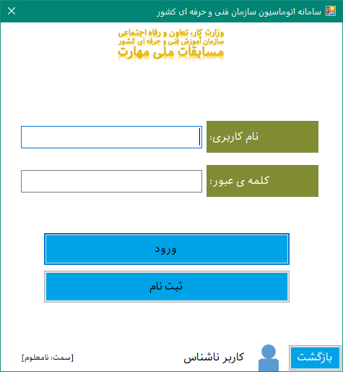
Login

Slide 3
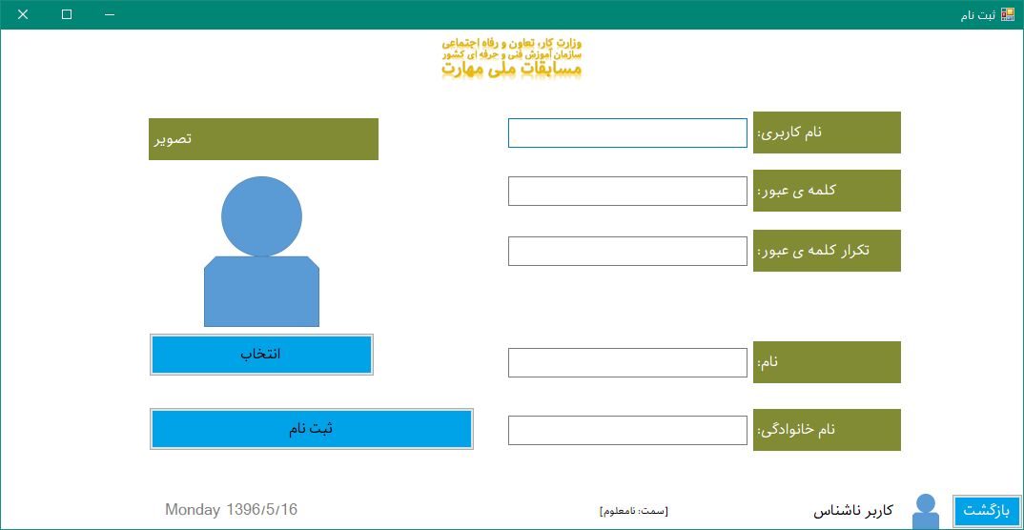
Registration Form

Slide 4
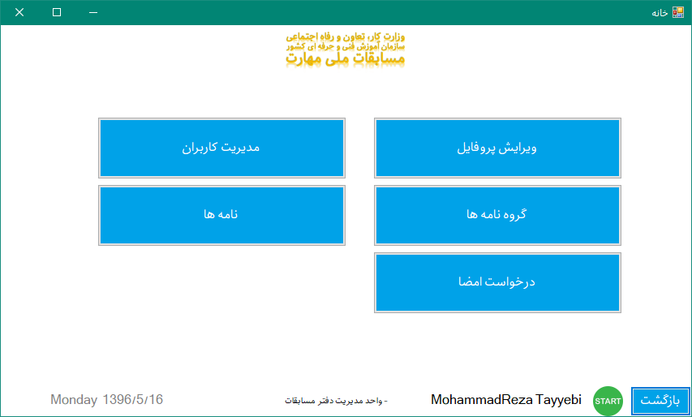
Main Dashboard

Slide 5
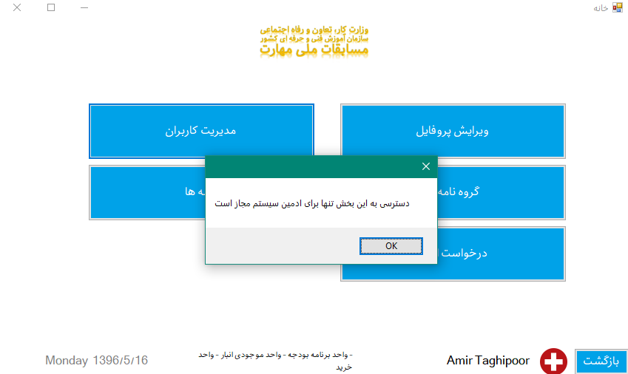
Banned Access for non permitted users

Slide 6
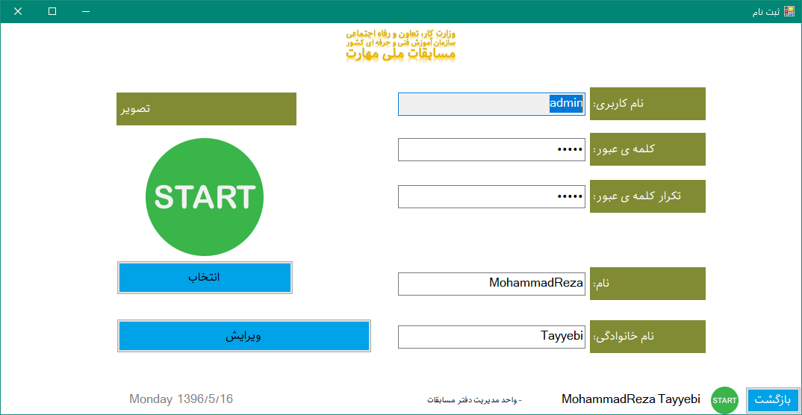
Edit Profile

Slide 7
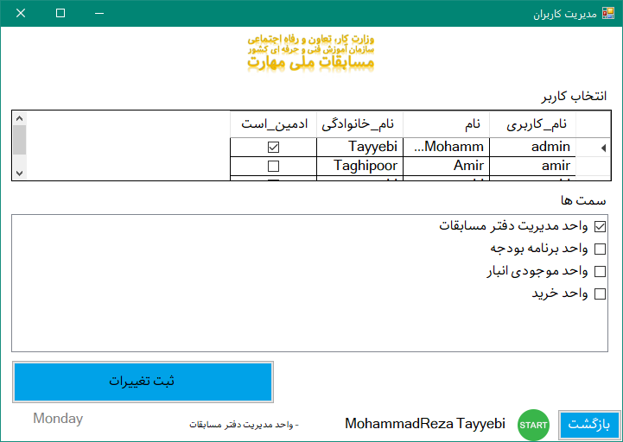
Manage Users (administrator)

Slide 8
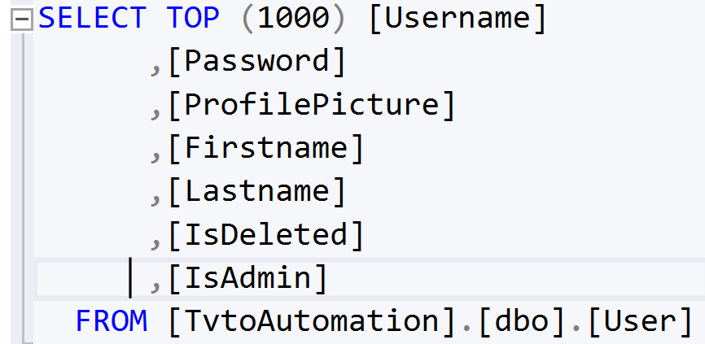
Administrator
Some one who is permitted to manage other users and his/her access is granted from database

Slide 9
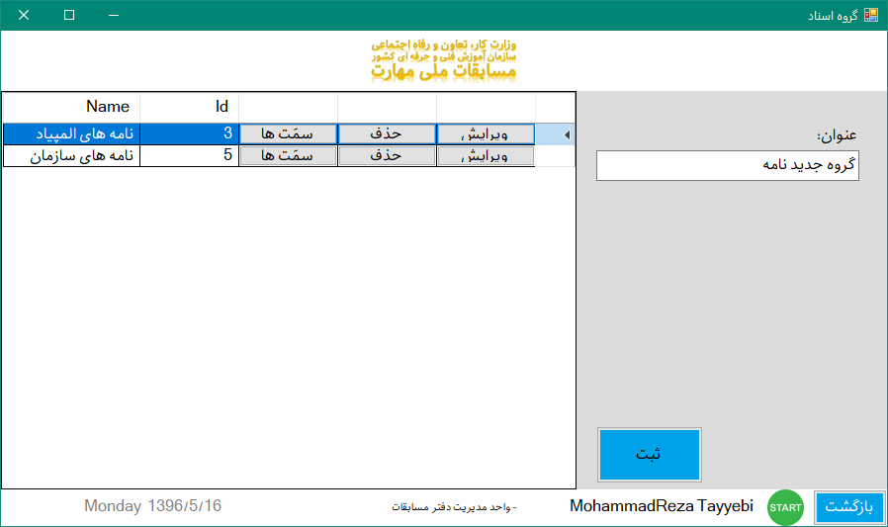
Documents Management

Slide 10
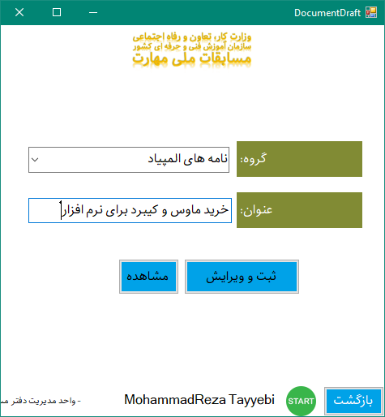
Create new Documents
Edit
Delete (if no related transactions)

Slide 11
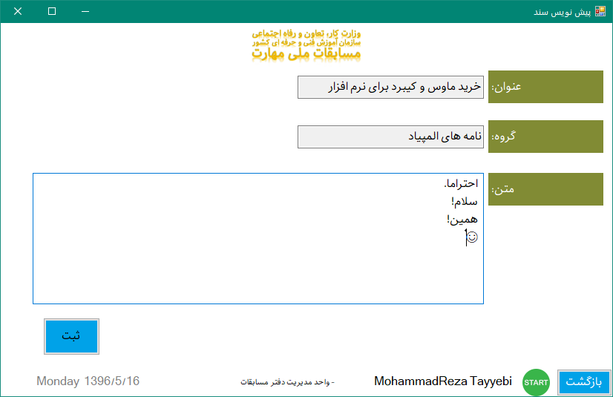
Drafting

Slide 12
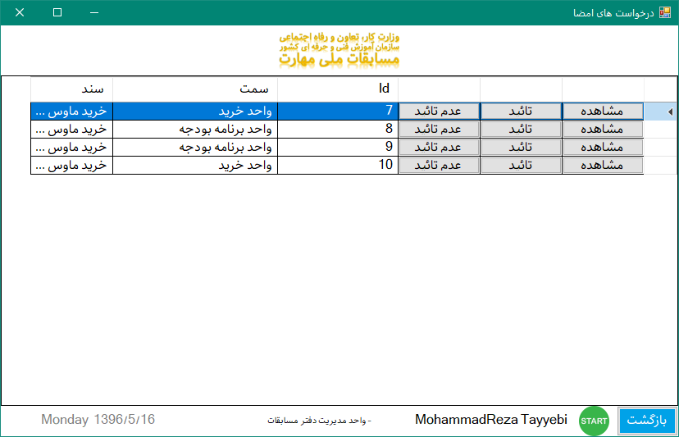
Accept the documents and monitor new requests!!!

Slide 13
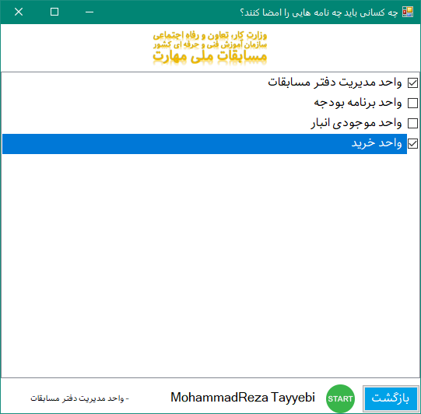

Slide 14
What else do you want?
Let’s have a little technical info

Slide 15
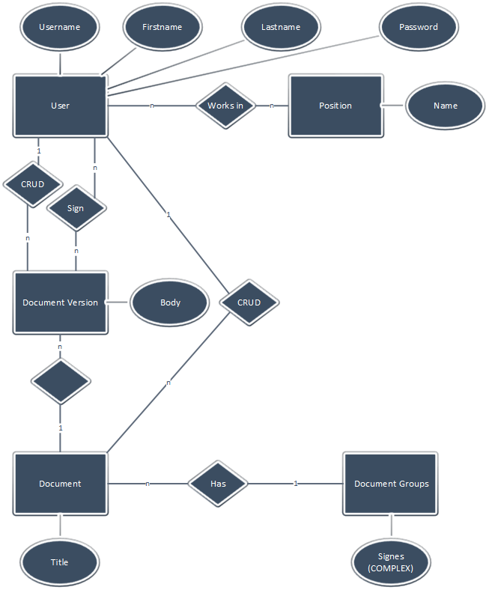

Slide 17
Supports and contact:
12 hpd
5am – 5 pm
mailto: rexa@gordarg.com

Slide 18
Thanx

